Slide 1
Single Image Haze Removal Using Dark Channel Prior
Самойленко Александр,
ФУПМ МФТИ

Slide 2
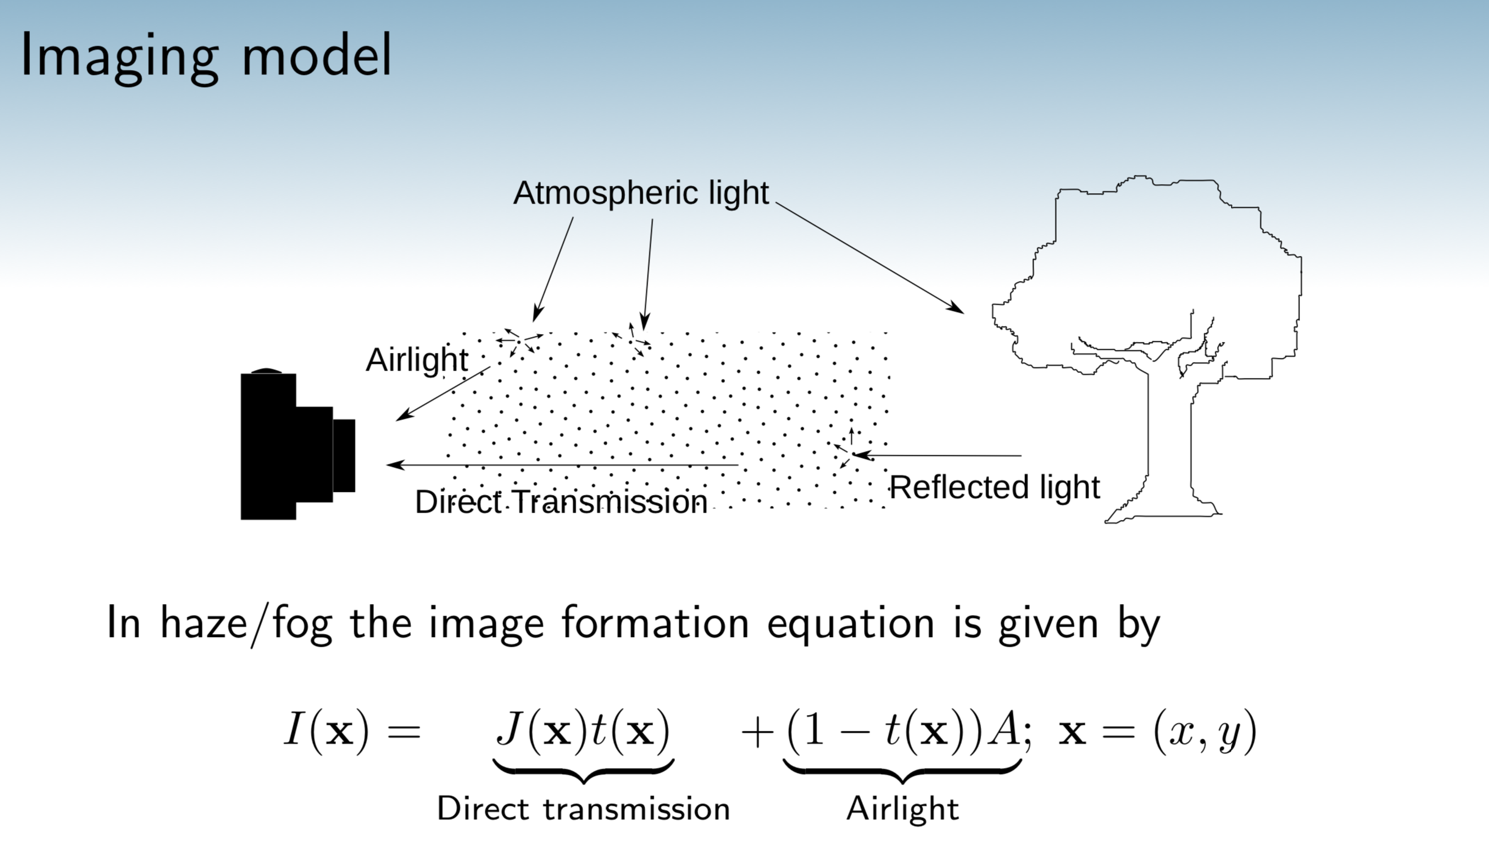
http://san-santra.github.io/dehaze_ncvpripg15/slide_ncvpripg15.pdf

Slide 3
Dark Channel Prior

Slide 4
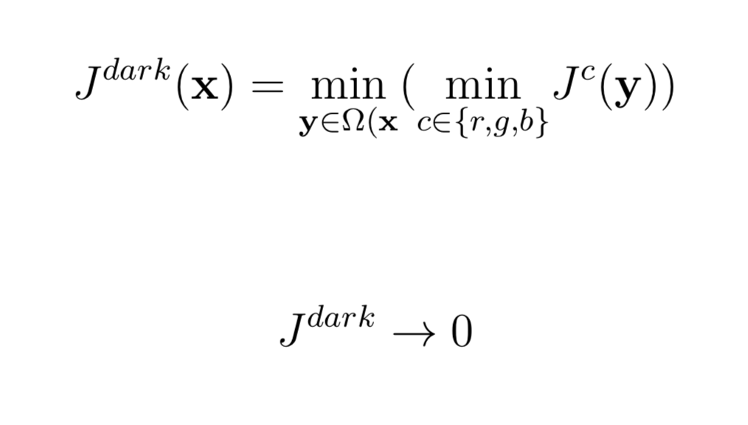
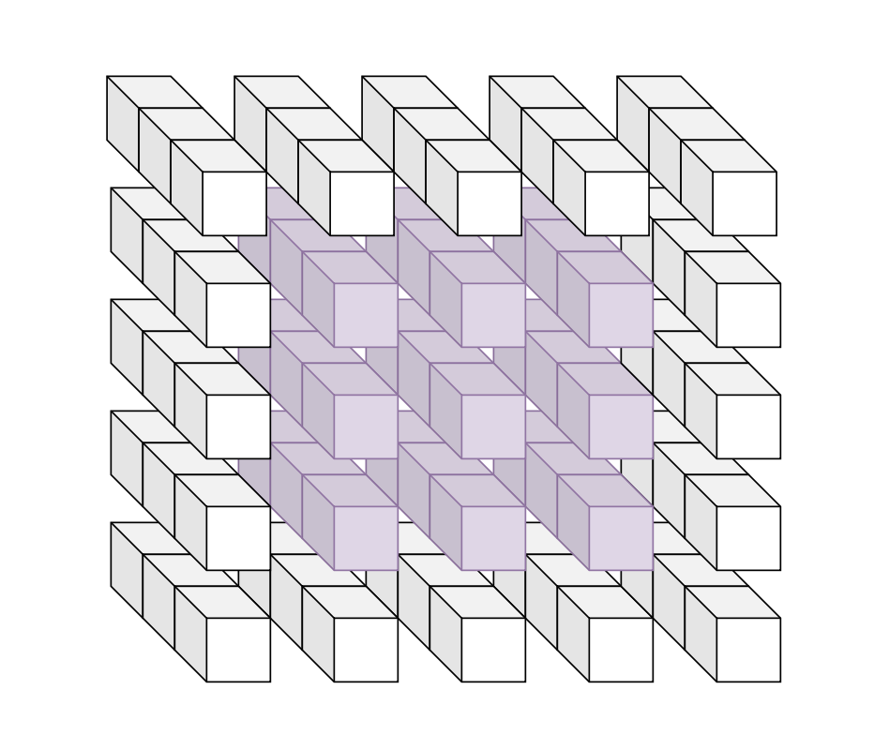
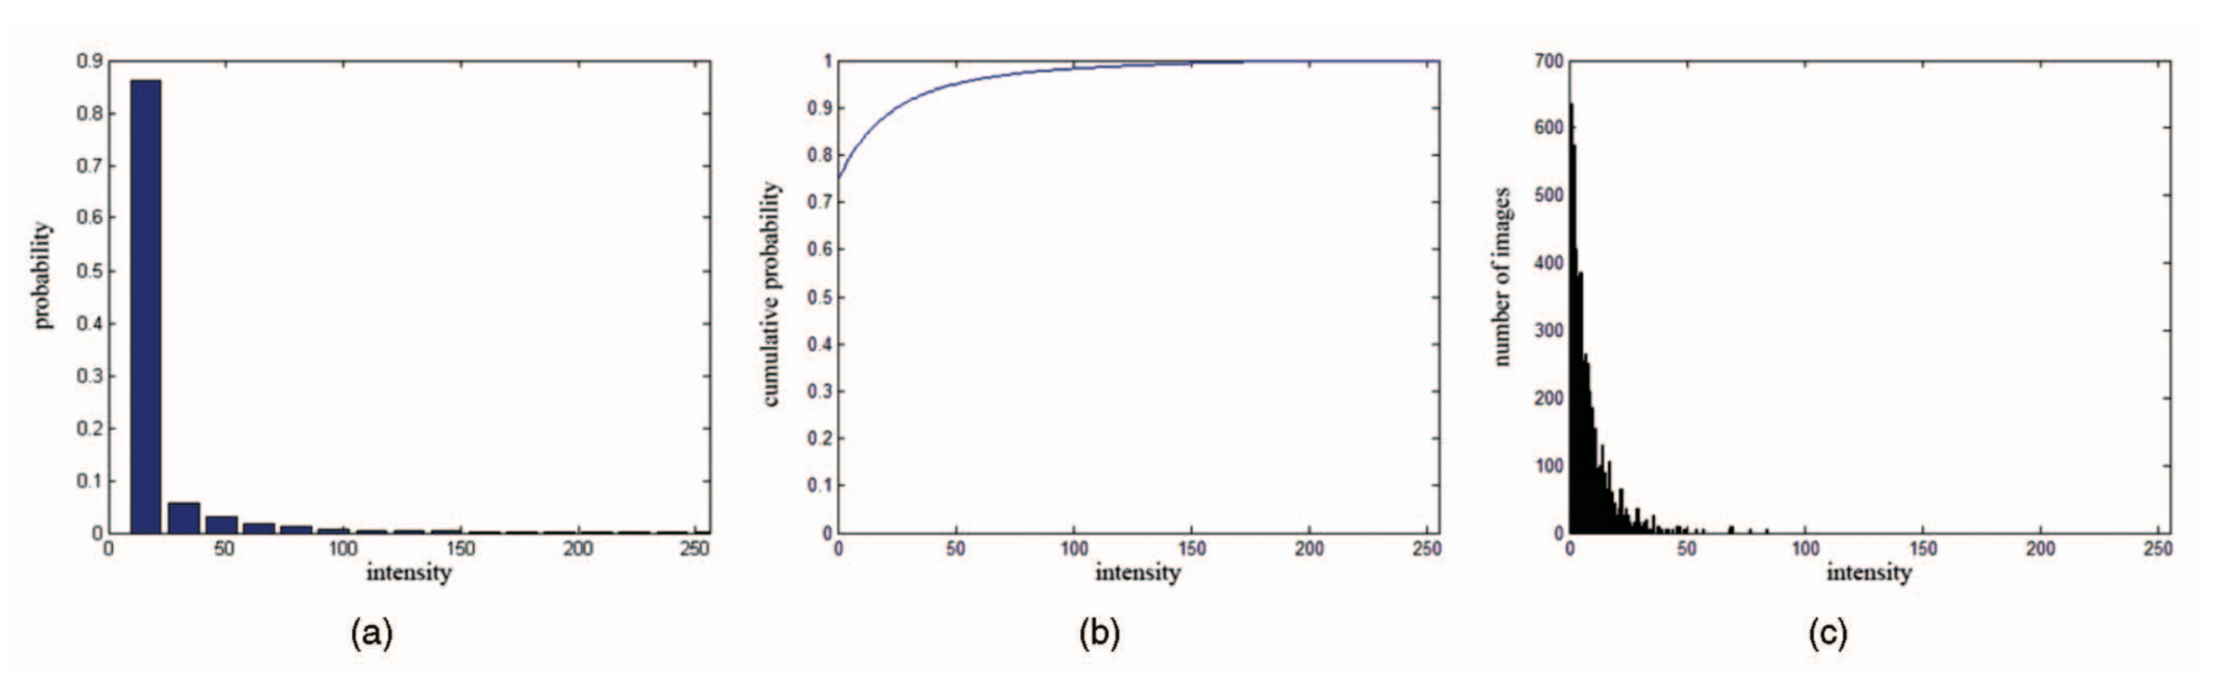
Dark Channel Prior

Slide 5
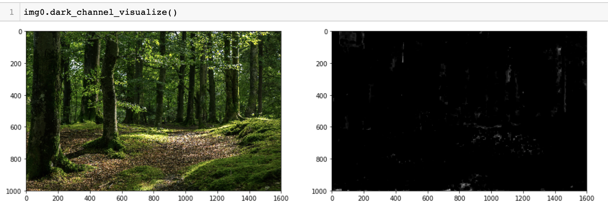
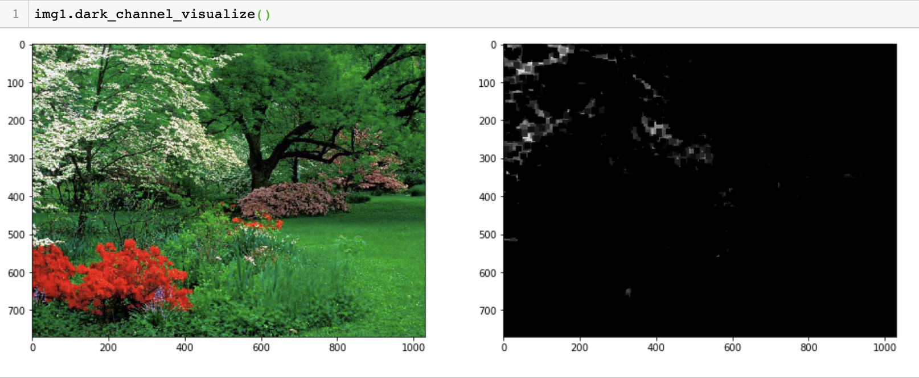

Slide 6
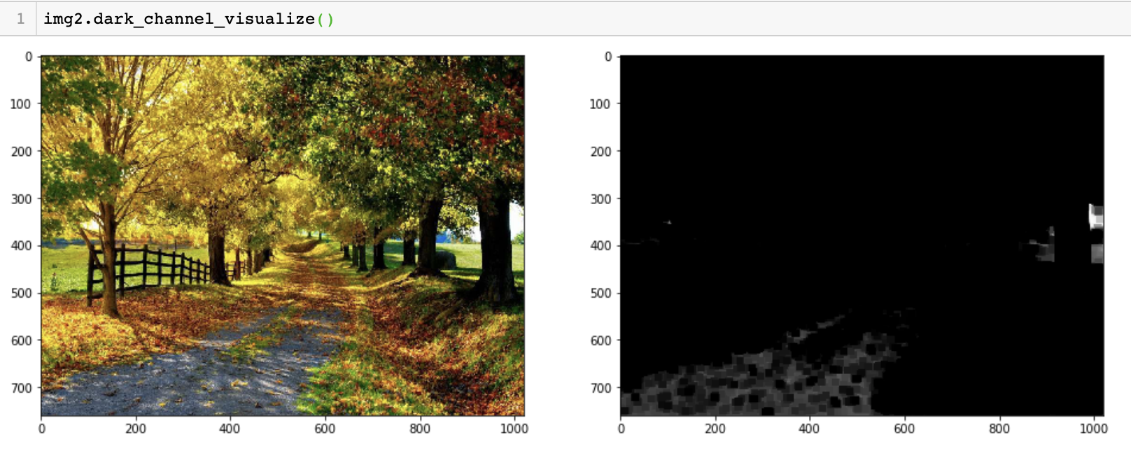
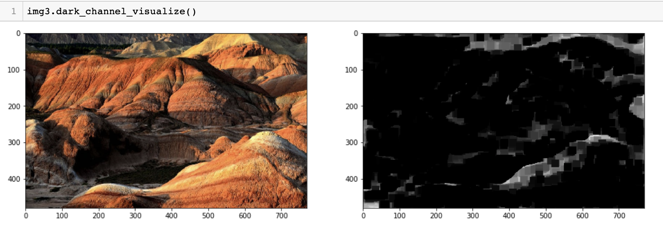

Slide 7
Atmospheric Light

Slide 8
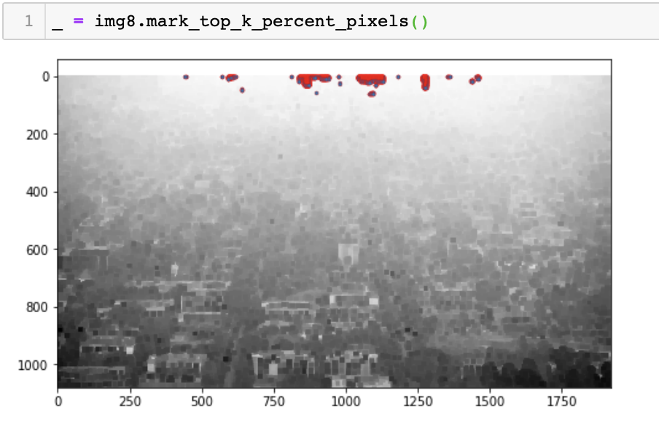
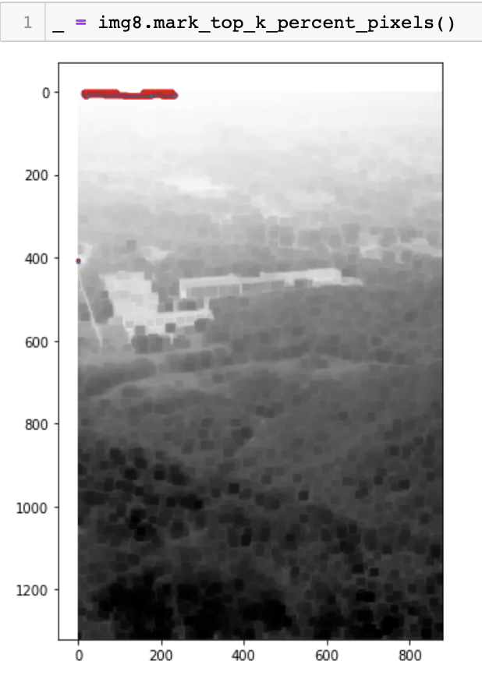
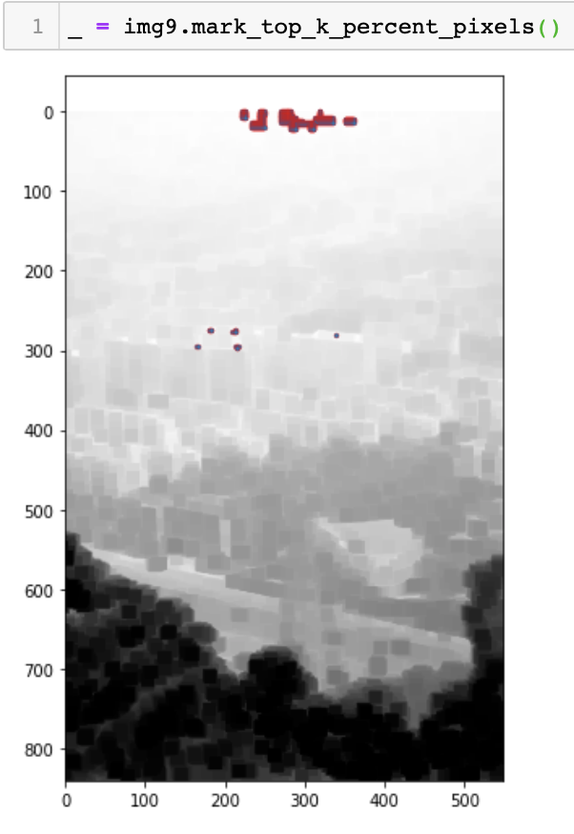

Slide 9
Transmission

